Slide 1

Student Utility Hub (SUB Mobile Application)
By Ashriel Nhembo
Talasla Vamsi Krishna
Notes:
1

Slide 2
Contents
1. Project Proposal (Problem & Solution) | 7. Graphical User Interface (GUI Design)
2. Target Users & Audience | 8. Experiment & Testing (Survey Analysis)
3. Comparison with Existing Solutions | 9. Usefulness & User Impact
4. Methodology | 10. Evaluation System (Scoring, Quiz & Formula)
5. System Logic Diagram | 11. Limitations & Future Plan
6. Application Pipeline (Workflow Process) | 12. Demonstration (Input/Output), Conclusion & References

Slide 3
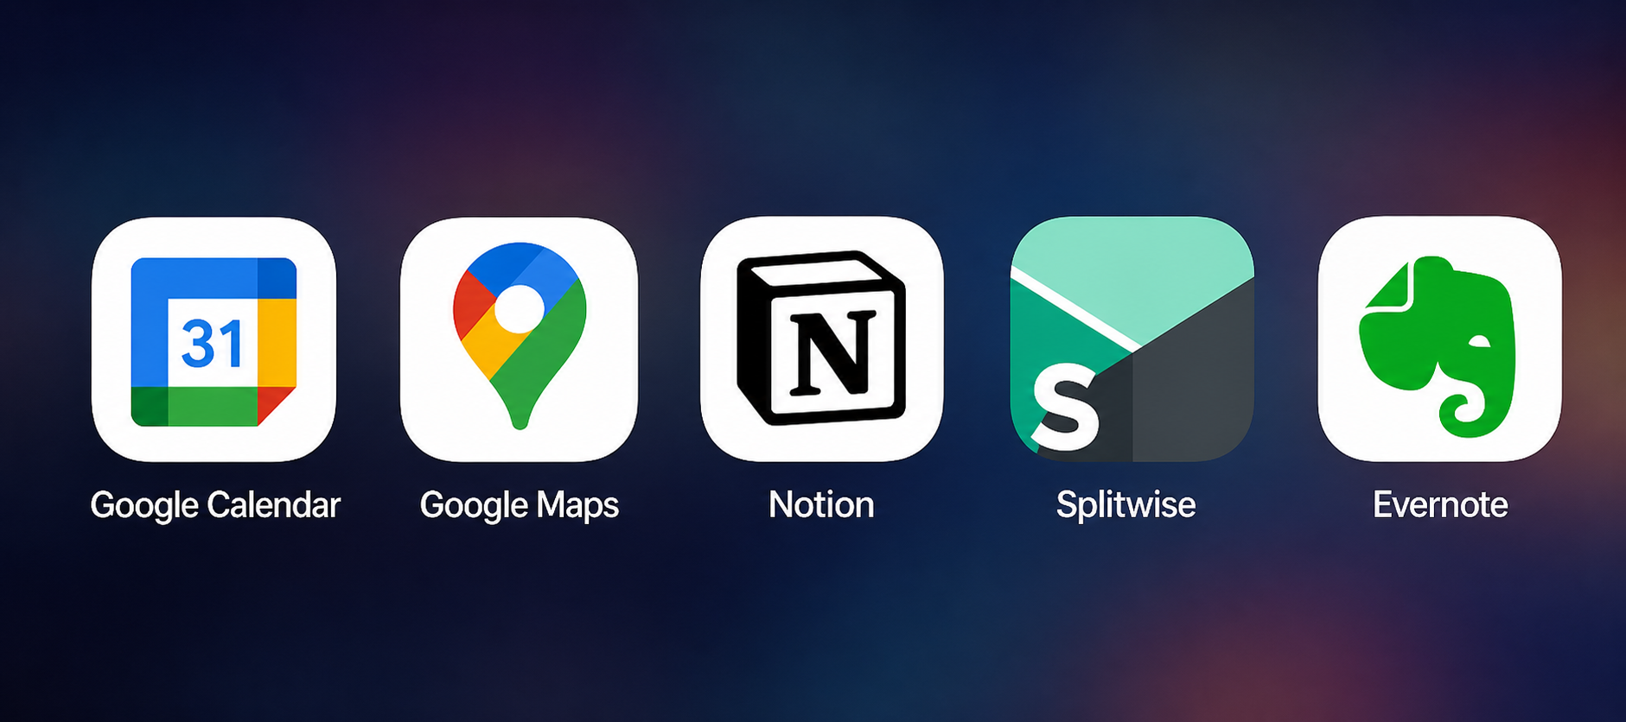
State of Art
“Students today rely on multiple disconnected apps for scheduling, budgeting, and daily tasks, creating inefficiency, confusion, and stress.”
Current Systems/Apps
Limitations of Current Solutions
Each app solves only one problem
No integration between features
Not specifically designed for students
Requires switching between multiple platforms
Some tools are complex for beginners

Slide 4
Project Proposal (Problem & Solution)
Problem Solution
A centralized all-in-one mobile application for student life management
Combines:
Class scheduling
Budget tracking
Task & assignment management
Local services & navigation support
Designed specifically for student needs, not general users
Problem Statement
Students struggle to manage academic tasks and daily life efficiently
Use of multiple apps (calendar, budgeting, notes, maps) creates confusion
Missed deadlines and poor schedule organization
Overspending due to lack of budget tracking
Difficulty adapting to a new environment (especially international students)
Information is scattered, not centralized

Slide 5
Target Users & Audience
Users
University Students Need help managing schedules, assignments, and daily tasks
International Students Face challenges adapting to a new country (transport, budgeting, services)
New / First-Year Students Struggle with organization and time management
Busy Students (study + part-time work) Need efficient tools to balance responsibilities
Student Associations & Clubs Manage events, communication, and activities
Universities / Institutions Can support students with a centralized platform

Slide 6
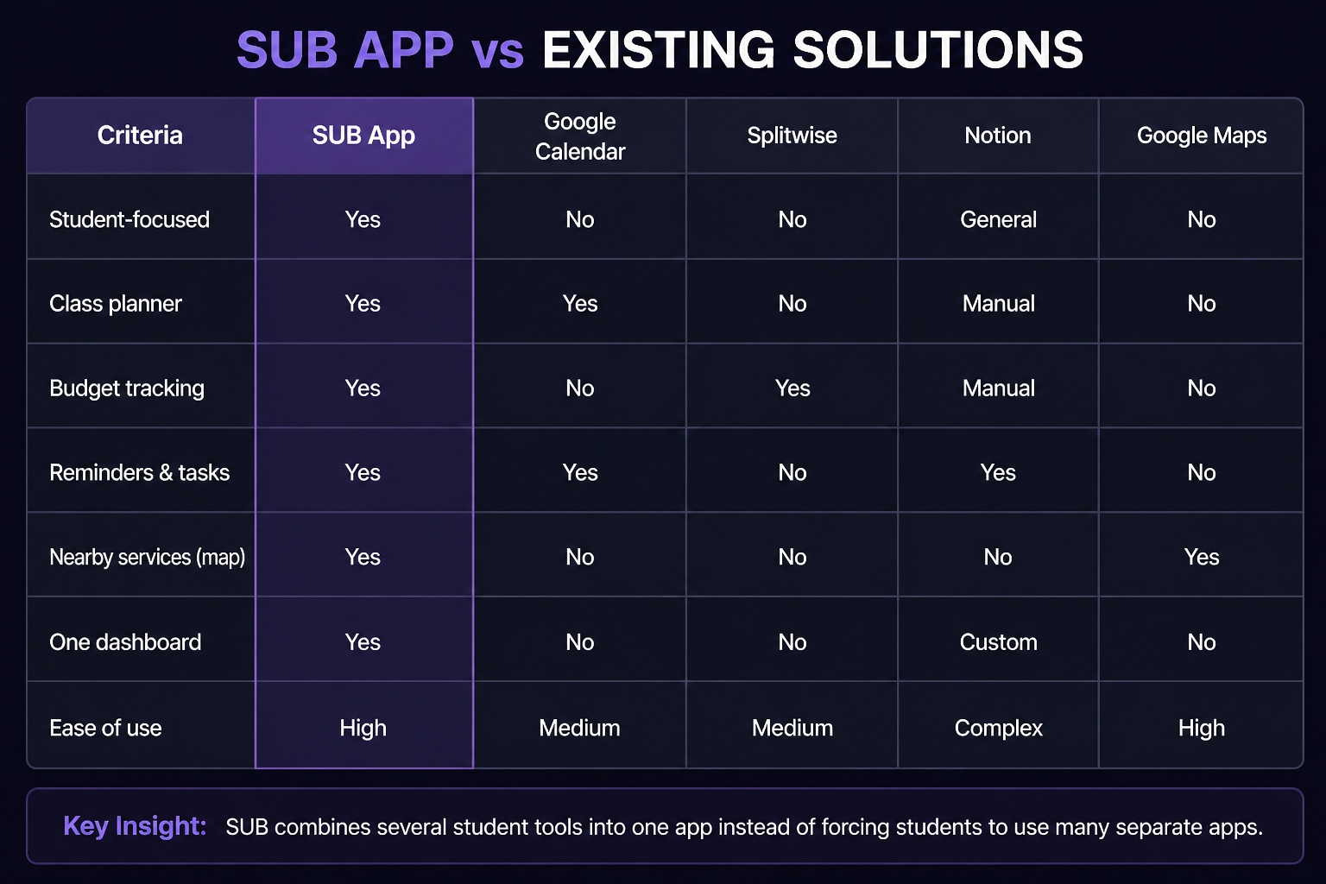
Comparison with Existing Solutions
“This comparison clearly shows that while existing applications are strong individually, none provide a complete, student-focused solution like our app.”

Slide 7
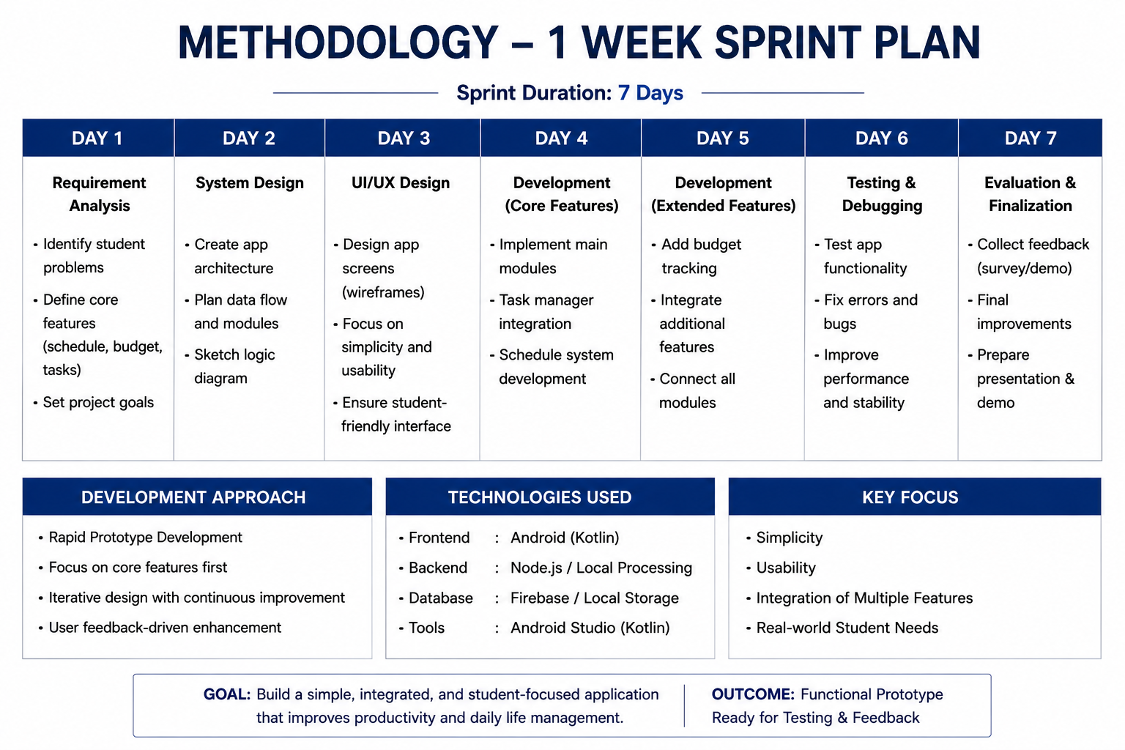
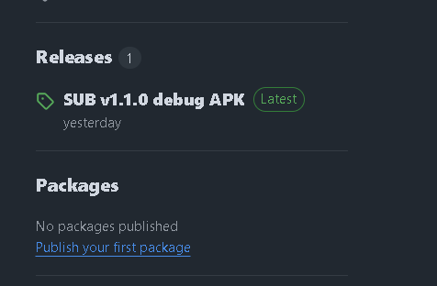
Methodology
APP demo after 1 week Sprint

Slide 8
Technologies
SUB is developed as an Android application using Android Studio, Java or Kotlin for logic, XML or Jetpack Compose for interface design, local database storage for user data, and APK packaging for installation and demonstration
Technology | Use
Android Studio | Main software used to build and test the Android app
Java / Kotlin | Programming language for app logic and features
XML Layouts / Jetpack Compose | Used to design app screens and user interface
SQLite / Room Database | Used to save tasks, schedules, budget data, and scores locally
GitHub | Version Control
Firebase Authentication | User login, registration, password reset, Google sign-in
Firebase Firestore / Realtime Database | Store user profile data online

Slide 9
5
System Logic Diagram

Slide 10
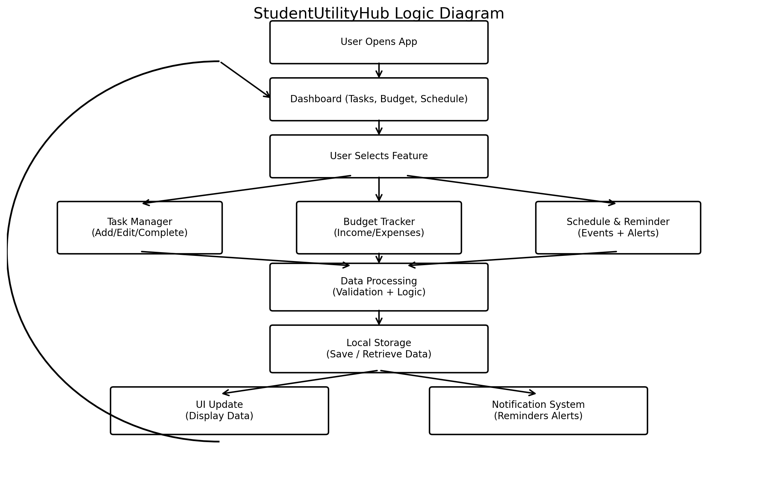
System Logic Diagram

Slide 11
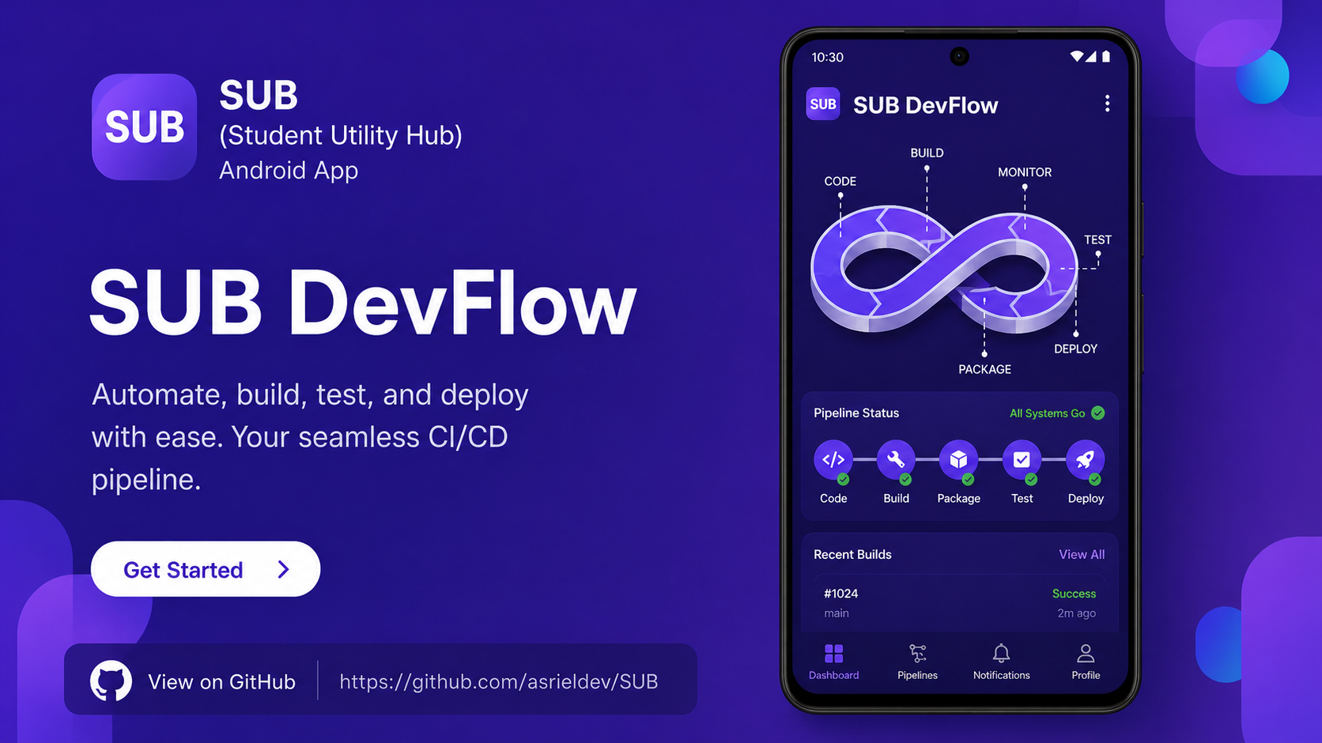
Application Pipeline (Workflow Process)

Slide 12
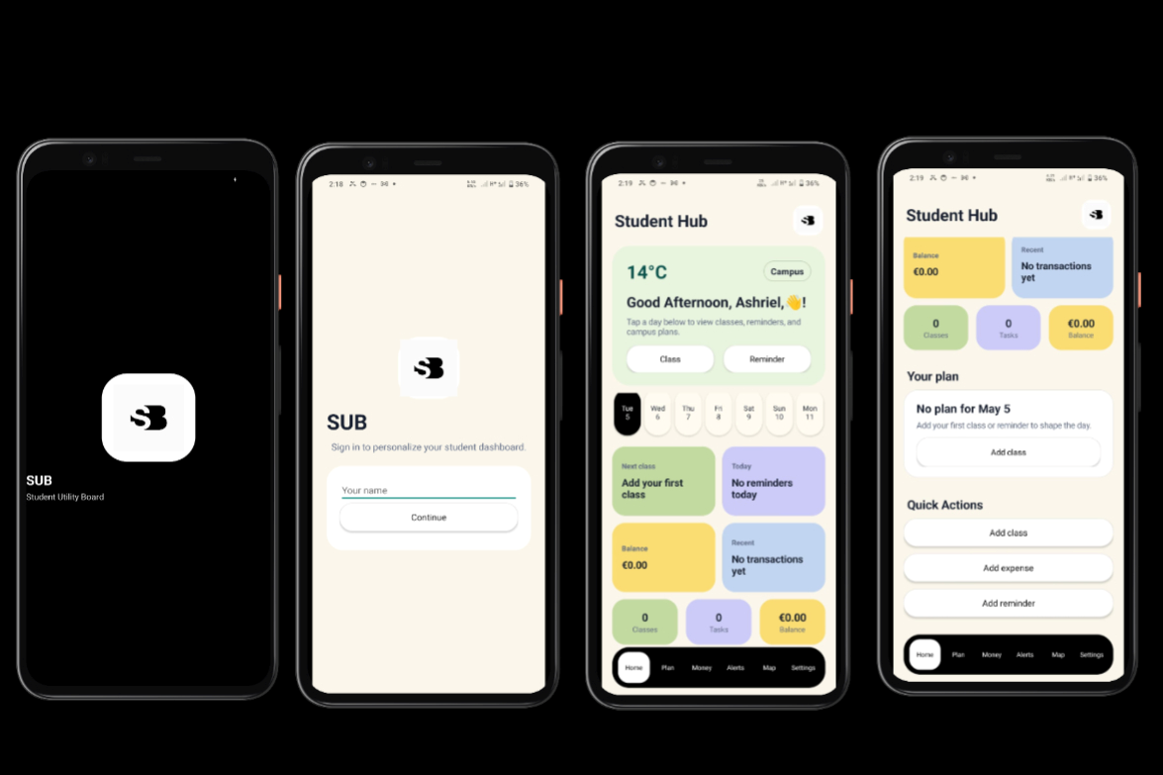
Graphical User Interface (GUI Design)

Slide 13
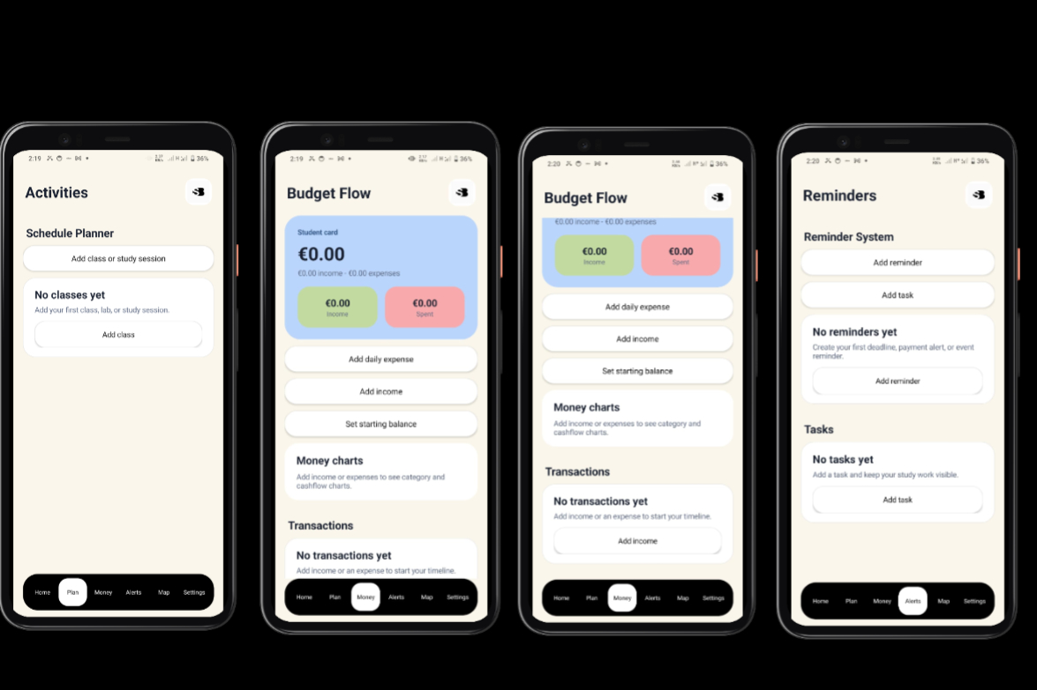
Graphical User Interface (GUI Design)

Slide 14
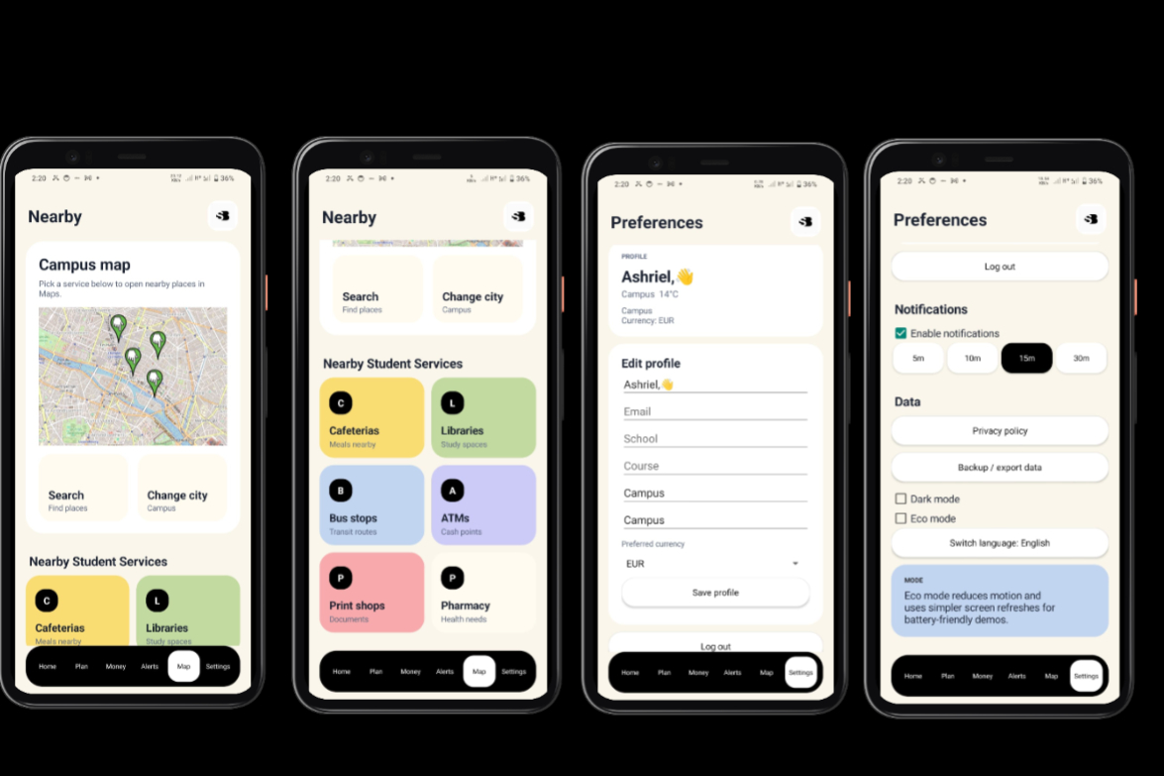
Graphical User Interface (GUI Design)
Eco mode & dark mode

Slide 15
Experiment & Testing (Survey Analysis)
Question | Option A | Option B | Option C | Result Insight
Do you find this app useful? | Yes (85%) | Maybe (10%) | No (5%) | Strong interest in the app
Which feature is most important? | Schedule (40%) | Tasks (30%) | Budget (30%) | Core features are well-balanced
Is the interface easy to understand? | Yes (80%) | Medium (15%) | No (5%) | UI is simple and user-friendly
Would you use this app regularly? | Yes (75%) | Maybe (20%) | No (5%) | High potential adoption
What improvement is most needed? | Notifications (50%) | Simplicity (30%) | More features (20%) | Focus on reminders and simplicity

Slide 16
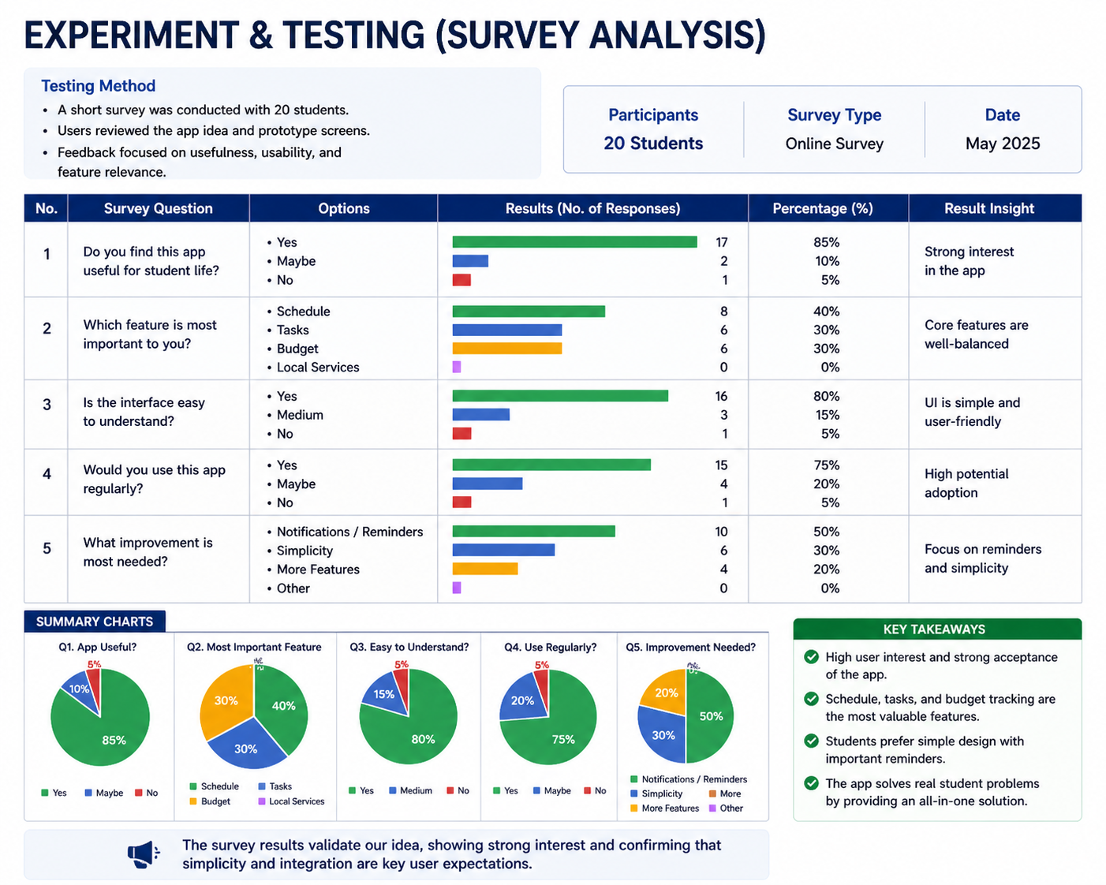

Slide 17
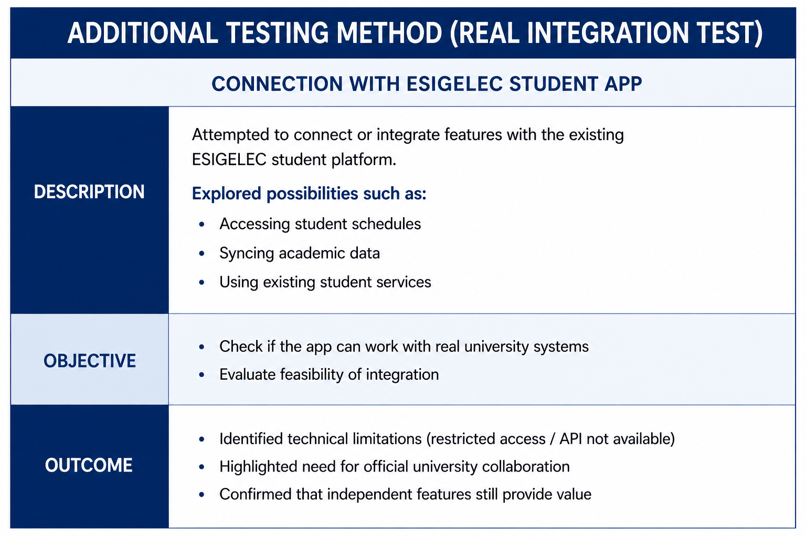

Slide 18
Usefulness & User Impact
Impact on Students
Improves productivity (better time management & reminders)
Reduces stress from missed deadlines and disorganization
Helps control spending with budget tracking
Supports adaptation to a new city (especially international students)
Practical Usefulness
Centralizes schedule, tasks, budget, and services in one app
Reduces need to switch between multiple tools
Provides quick access to essential student features
A simple, all-in-one solution that improves student life, organization, and financial awareness

Slide 19
Evaluation System (Scoring, Quiz & Formula)
Purpose: To measure how useful and effective the app is for each student based on their activity, organization, and feedback.
Criteria | Description | Score
Task Completion | Number of completed tasks/assignments | 25 pts
Schedule Usage | Frequency of using class planner | 20 pts
Budget Control | Staying within monthly budget | 20 pts
Quiz Result | Student life / productivity quiz score | 15 pts
User Feedback | Rating given by the user | 20 pts
Total | Overall app effectiveness | 100 pts

Slide 20
Evaluation Criteria
Scoring Formula
Final Score = Task Score + Schedule Score + Budget Score + Quiz Score + Feedback Score
Example: Final Score = 20 + 18 + 15 + 12 + 17 = 82 / 100
Score Interpretation
Score Range | Meaning
80–100 | Excellent usefulness
60–79 | Good usefulness
40–59 | Average usefulness
Below 40 | Needs improvement

Slide 21
Limitations & Future Plan
Current Limitations
No direct integration with university systems (e.g., schedules not auto-synced)
Prototype stage → limited features and scalability
Manual data entry required (tasks, budget, timetable)
Basic UI → not fully optimized for all users
Limited testing sample → results may not generalize
Note: At the moment we haven’t implemented authentication as its a demo .

Slide 22
Future Plan
Short-Term Improvements
Add notifications & smart reminders
Improve UI/UX design (cleaner, faster navigation)
Enhance budget analytics (charts, insights)
Mid-Term Enhancements
API integration with university platforms (if access available)
Add AI-based recommendations (study planning, spending advice)
Enable data import (timetable upload, auto-fill)
Long-Term Vision
Expand to multiple universities and cities
Build a cross-platform app (Android + iOS)
Create a student ecosystem platform (events, community, services)

Slide 23
Future improvement include bank and card integration, security must be very strong because it involves money and personal data.
How To Achieve Strong Security?
Use official bank/payment APIs, not direct access to bank accounts.
SUB will use secure bank APIs, OAuth authentication, encryption, HTTPS communication, and payment security standards like PCI DSS. The app will not store sensitive details such as passwords, PINs, CVV, or full card numbers
Security Method | Purpose
OAuth 2.0 | Lets users connect bank accounts without sharing passwords
Encryption | Protects data when stored and transferred
HTTPS / TLS | Secures communication between app and server
Token-based access | Uses temporary access tokens instead of passwords
Firebase/Auth or secure backend login | Protects user accounts
Biometric login | Fingerprint or face unlock for extra protection
PCI DSS compliance | Required if handling card/payment data
OWASP mobile security testing | Checks the app for security weaknesses

Slide 24
Conclusion
The project proposes a student-centered, all-in-one mobile application
Addresses key challenges:
1. Time management
2. Budget control
3.Daily organization
Combines multiple tools into a single, simple platform
Survey and testing confirm strong usefulness and demand
Provides a solid foundation for future development and scaling

Slide 25
Annex
1. Project Proposal (Problem & Solution) | Slide 4
2. Target Users & Audience | Slide 5
3. Comparison with Existing Solutions | Slide 6
4. Methodology | Slide 7
5. System Logic Diagram | Slide 9
6. Application Pipeline (Workflow Process) | Slide 10
7. Graphical User Interface (GUI Design) | Slide 11-13
8. Experiment & Testing (Survey Analysis) | Slide 14 -16
9. Usefulness & User Impact | Slide 17
10. Evaluation System (Scoring, Quiz & Formula) | Slide 18-19
11. Limitations & Future Plan | Slide 20-21

Slide 26

SUB
New centralised Student Application
Demo_APP.mp4
Feedback link
Release SUB v1.1.0 debug APK · asrieldev/SUB

